Slide 1
EUROlinkCAT Variables Database
What is the ‘Variables Database’
Online depository of the available variables in the linked datasets
Variables from the Mortality, Morbidity, Education and Prescription datasets
Note Variable descriptions – NOT data
Contains 4063 variable descriptions from 42 datasets
Purpose
Provide a central variable reference library
Allows categorisation of variables and more importantly a ‘mapping’ to the defined EUROlinkCAT variables in the various study protocols
Reference library for potential future studies
Extract selected information to Excel

Slide 2
Details recorded for each variable include:
Dataset name
Table name
Variable name
Description
Format
Comments/notes
Data years – years available from/to
Completeness
Coding for categorical variables
Mapping to study EUROlinkCAT variable

Slide 3
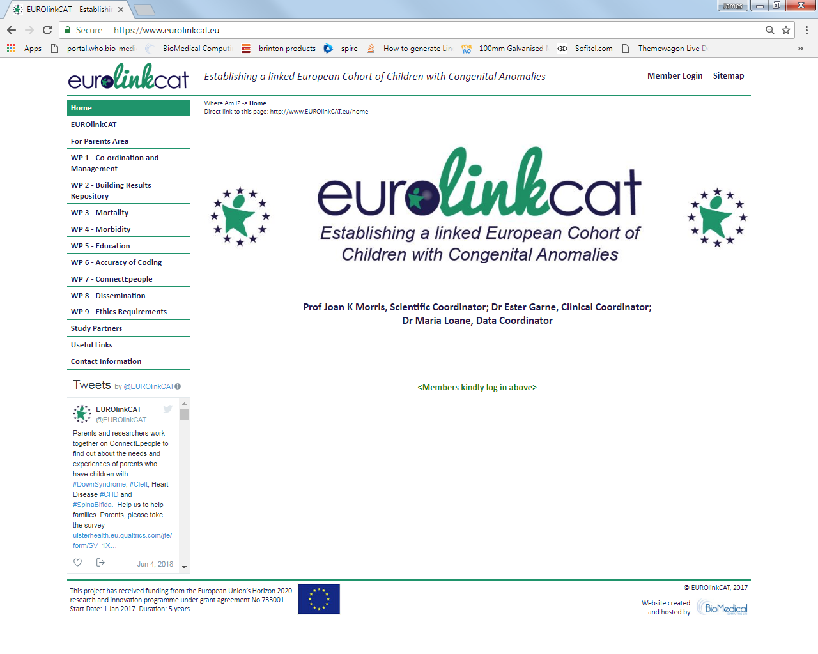

Slide 4
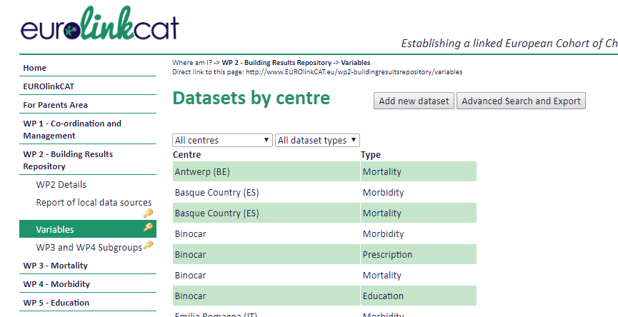

Slide 5
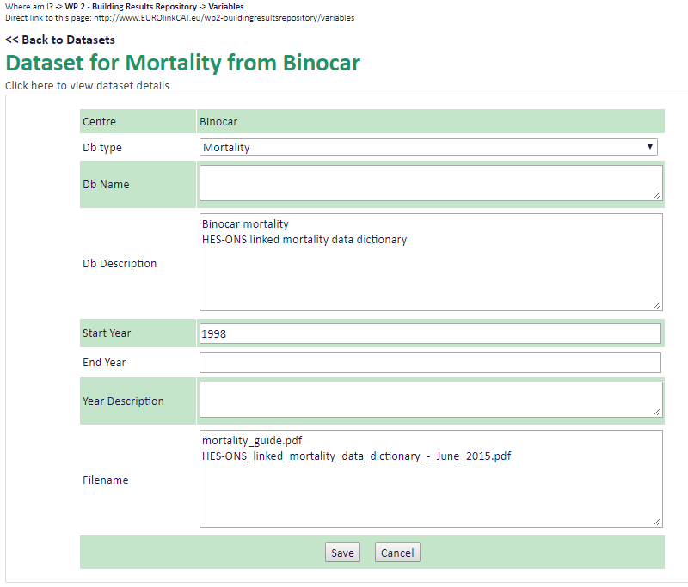

Slide 6
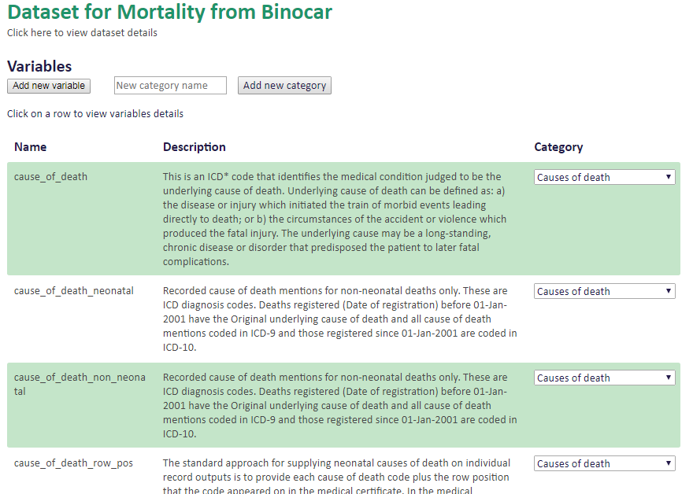

Slide 7
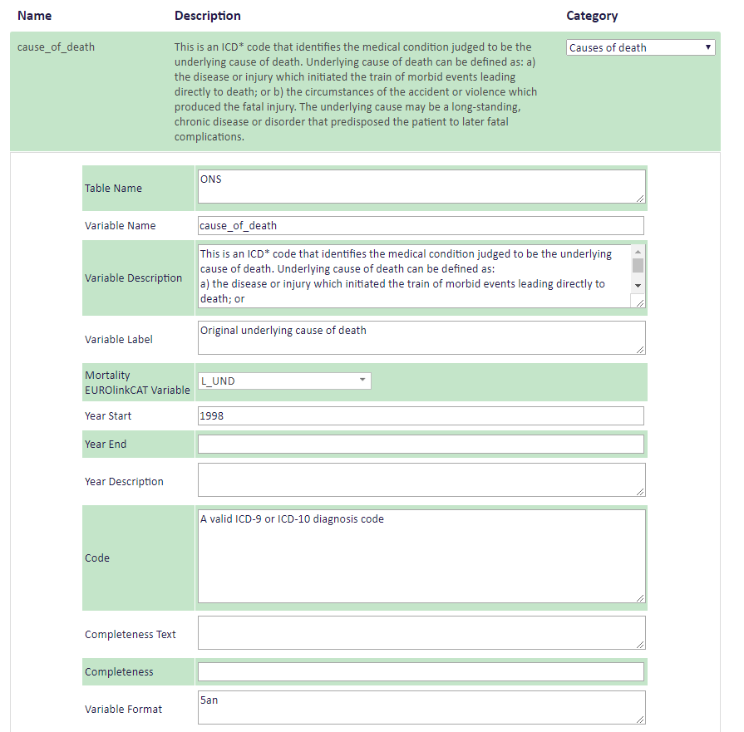

Slide 8
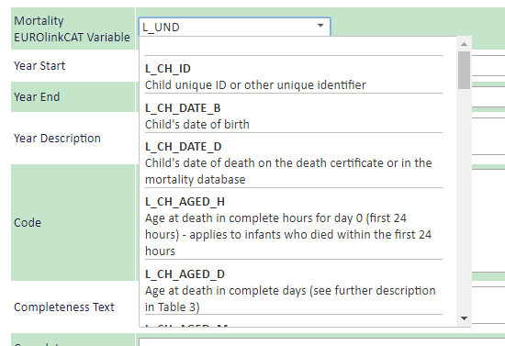

Slide 9
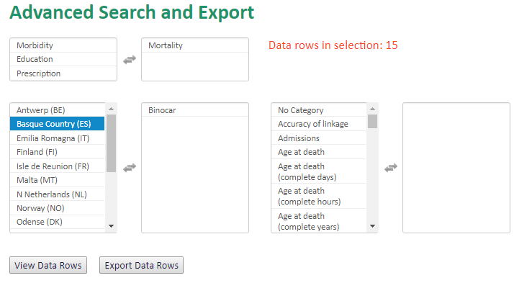

Slide 10
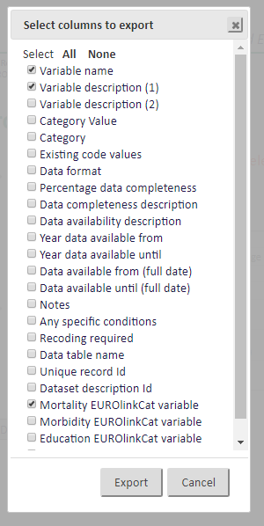

Slide 11
