Slide 1
Work Package 1 - Coordination
2018 Registry Leaders Meeting
June 12th, 2018

Slide 2
Overview of Progress
On track! – all Deliverables successfully submitted, with 1 exception…
The Zagreb Parent Consultation meeting (D8.2)
cancelled
Local focus groups with parents
Core project team meetings over the past 18 months:
6 Steering Group
7 Standardization Group
2 Ethics Data Protection Board
2 Full Consortium
Monthly work package-specific meetings using GoToMeeting
Scientific Protocols created for WP3, WP4, WP5
Common variables compiled and defined
Analysis Plans produced, various surveys performed
ConnectEpeople online platform created and online

Slide 3
Scientific Report
An annual scientific report was compiled (available on closed website)
Work Package Leaders will update this scientific report to cover the first 18 months. It will include accomplishments and deviations from the project plan
Work Package Leaders may contact you for specific information to complete this report
This will be the periodic scientific report to the European Commission submitted via the EC portal by start August 2018

Slide 4
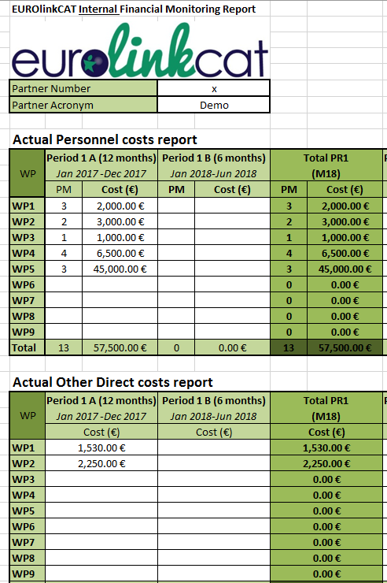
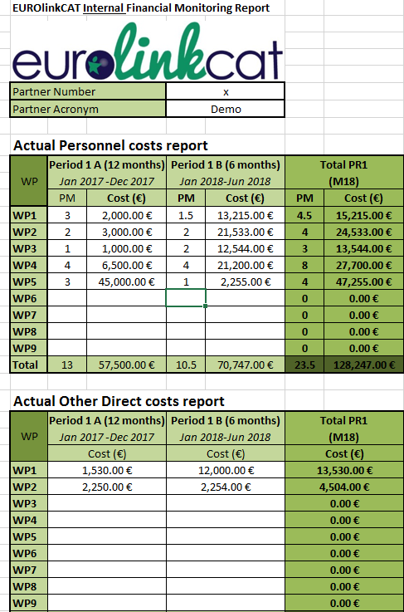
Financial report
All partners collected the first 12 months of financial information (Months 1-12) and submitted it to QMUL.
The same reporting form should be used to report the next 6 months to QMUL (Months 1-18).
Please submit your reports to QMUL by July 20th 2018
A detailed email will be circulated shortly
Ensure your finance people are ready to complete this on time.
Notes:
Hopefully this has been instructive for the teams to locate any budgetary issues.

Slide 5
Submitting Approved Financial Reports
QMUL will look at financial reports and approve them.
Beneficiaries and linked third parties will then have to enter the financial information into the EC portal and submit them to the Commission by start August 2018.
The reports will be combined automatically by the system into a consolidated financial statement.
If you fail to do so, your costs will be considered 'zero' for this reporting period (though you can declare them in the next reporting period).
There are guidelines available on the EC Portal, the EUROlinkCAT website or ask Nicholas for help.

Slide 6
Deliverables Update
 | Deliverable Title | Est. Del Date | Status
D8.1 | Information Leaflet | 02/2017 | Approved
D9.2 | NEC - Requirement No. 2 | 02/2017 | Submitted
D2.1 | Build Website | 03/2017 | Approved
D1.1 | Initial Website Online | 05/2017 | Approved
D9.3 | POPD - Requirement No. 3 | 06/2017 | Submitted
D7.1 | Formation of e-stakeholder forum "ConnectEpeople" | 02/2018 | Submitted
D8.2 | Consultation meeting | 02/2018 | Changed
D9.1 | Ethics Approval portfolio | 12/2018 | In Process
D2.2 | Provide Linked aggregate data to WP3,4,5,6 | 03/2020 | Pending

Slide 7
Milestones Update
By 18 months we estimated we would complete 12 milestones established in the Grant Agreement, establishing the study, surveys, protocols, etc.
Completed Milestones: 9
MS1, MS3, MS10, MS11, MS12, MS13, MS15, MS16, MS24
Pending Milestones: 3
MS4 – Confirmation of the agreed variables standardised across Europe (The Common Model)
More complex than first thought
MS14 – Study Protocol for Infections and respiratory illness defined as use of medications during the first 5 years of life.
Almost done
MS25 – Synopsis of families research priorities for integration into WPs
Revised due date of June 2018

Slide 8
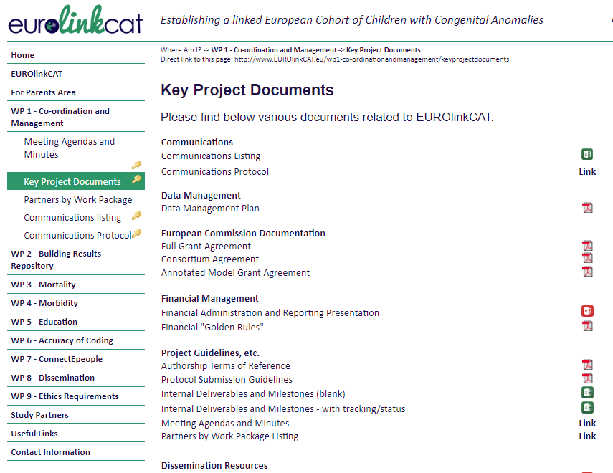
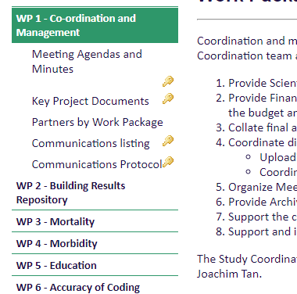
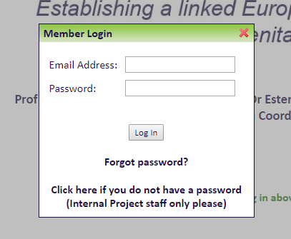
Website as a resource for project all partners
Re-designed to put many key documents in one place.
Minutes of the key meetings can be found there along with a variety of other project resources, guidelines, agreements, etc.
Great resource – for members.
If not - Contact me for any management, communications finance/budget related questions or referral. (Not the EC)
Please gain access by requesting access or emailing the coordinator
Suggest items for upload, etc. Help to improve the resource.

Slide 9
Parent Area and Twitter
New Parent section aims to make the lay summaries more accessible for parents.
Get access, ask for changes, give new ideas for improvements
Follow us on Twitter @EUROlinkCAT
Suggest Tweets! By emailing them to me

Slide 10
Thanks! Keep up the good work.

