Slide 1
WP7-ConnectEpeople Professor Marlene Sinclair - Ulster University Professor Anna Latos-Bielenska - Poznań University, Poland Dr Julie McCullough – Ulster University Dr David Elliott – Redburn Solutions, Northern Ireland

Slide 2
EUROlinkCAT ConnectEpeople Original objectives
To connect researchers with families who live with congenital anomalies (CA) across Europe to involve them in setting research priorities and ensuring that research results are disseminated in a meaningful way.
To establish a sustainable e-forum, “ConnectEpeople”, for providing regional, national and international support to families with congenital anomalies through maintaining the links between the EUROCAT congenital anomaly registries and the families.

Slide 3
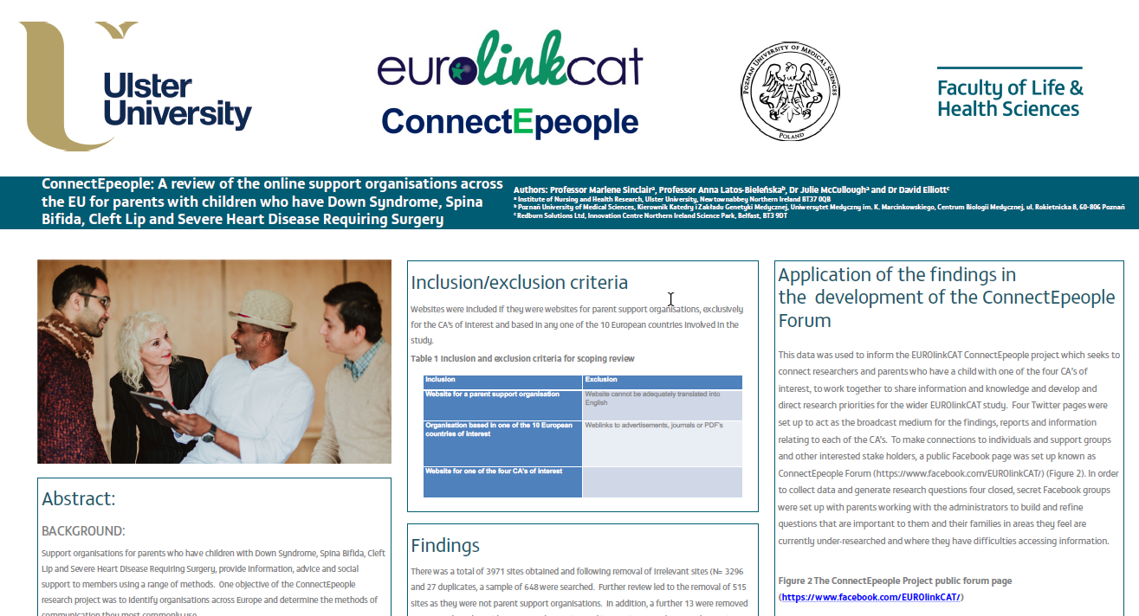
Scoping Review
Notes:
We completed a scoping review of parent organisations across 10 |European countries. Our poster is displayed outside.

Slide 4
Milestone 24 Communication networks used by parent support groups: A scoping review
The most common forms of communication used by Parent Support Organisations (n=120) across the 10 countries involved in EUROlinkCAT were email, Facebook and Twitter
82% of organisations use Facebook (n=96)
56% use Twitter (n=66)
These findings were used to inform the development of the eForum EUROlinkCAT - ConnectEpeople

Slide 5
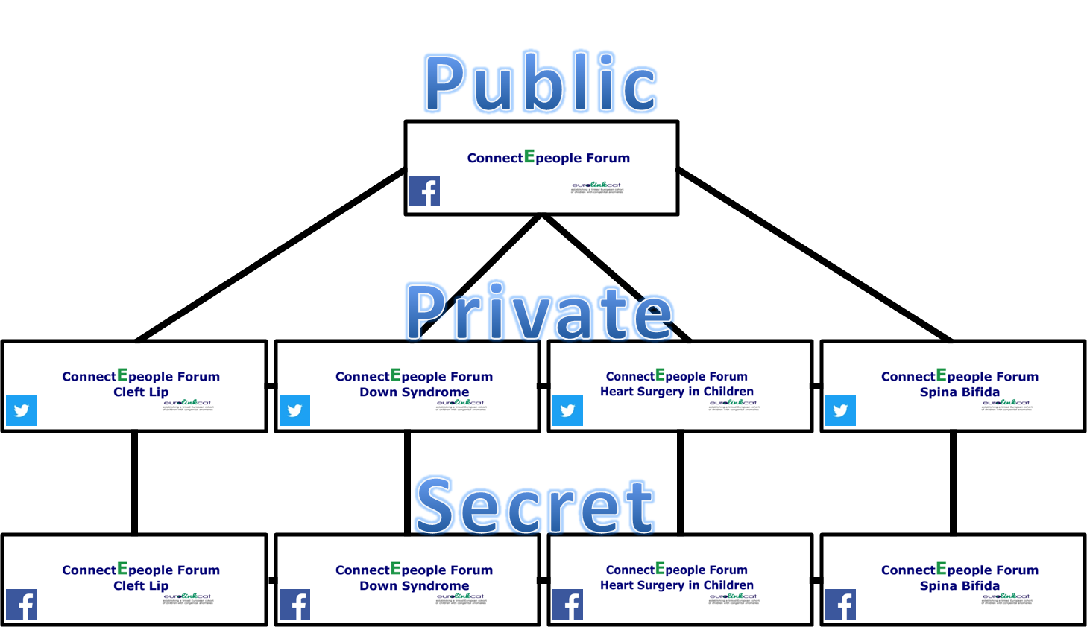
ConnectEpeople E-Forum
Notes:
3 phase forum

Slide 6
ConnectEpeople Social Media Analytics

Slide 7
ConnectEpeople Social Media Analytics

Slide 8
ConnectEpeople – Recruitment Profile
Congenital Anomaly | Number of parents participating in the eForum | Countries
Down Syndrome | 8 | Poland, UK
Spina Bifida | 2 | UK
Cleft Lip | 4 | Italy, Portugal, UK
Heart Defects | 1 | UK

Slide 9
EUROlinkCAT ConnectEpeople Research Parents Survey
Developed in partnership with ConnectEpeople parent participants
This survey will be the basis of Milestone 25 ‘Synopsis of families’ research priorities so WP leaders can incorporate into study protocols if possible.’

Slide 10
ConnectEpeople Parent Survey (Live on 24 May 2018)
This questionnaire asks for details regarding
Demographic information
Country of residence
Online connectivity
Preferred modes of communication with support groups
Research knowledge
Health information sources
Invitation to comment on WP Education, Mortality and Morbidity
Opportunity to provide a question that is important to them about CA

Slide 11
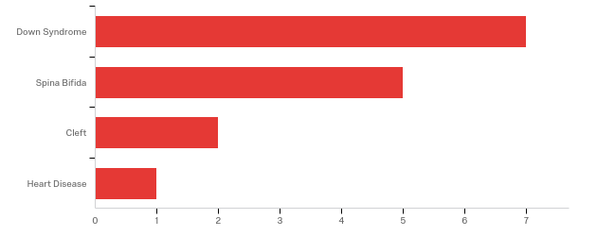
Congenital Anomalies of children whose parents have completed ConnectEpeople Survey (n=15)
Notes:
This is also reflected in the Facebook groups where most of those recruited are parents of children with Down Syndrome

Slide 12
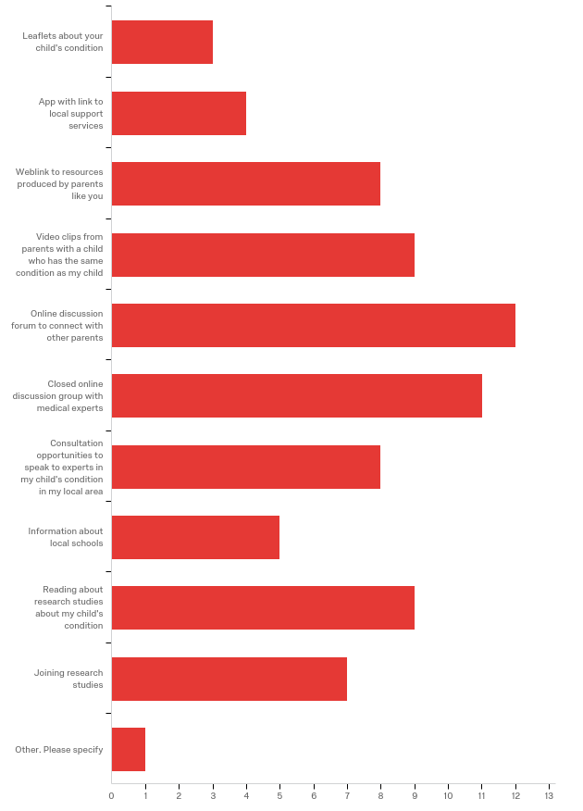
What is the best way to communicate with a parent like you?
Notes:
Longest bar = online discussion forum to connect with other parents
First bar is the shortest = leaflets about childs condition

Slide 13
Parents comments on WP5 Education
I am particularly interested in this work package and seeing what factors affect educational achievements and need (CL)
This is very important as most children with a disability can have careers if given the right support let them know how successful they can be (SB)
I do believe that educational needs of my child with heart conditions have not been very well met so this should be very beneficial (HD)
I think there is a huge gap between Poland and other EU countries in aspects of supporting kids with special educational needs (DS)

Slide 14
Sample of a research question from Parent of Child with Spina Bifida
What is the current situation with pre-birth intrauterine surgery for Spina Bifida?

Slide 15
Research questions from parents

Slide 16
Sample of a research question from Parent of Child with Heart Defect
Is there a link between taking Clomid and Heart defects in children?

Slide 17
Sample of a research question from Parent of Child with Down Syndrome
Does exercise enhance the immune system of children with Down Syndrome?

Slide 18
Sample of a research question from Parent of Child with Cleft Lip
How many twins have cleft lip?

Slide 19
ConnectEpeople - Next Steps
Analysis and identification of the Parent Survey research questions
Online Event for Spina Bifida Awareness Day, 25th October, 2018
Congenital Heart Defect Awareness Day, 14th Feb 2019
World Down Syndrome Day 21st March 2019
Notes:
Spina Bifida event, SHINE (UK), BOSK (Netherlands) have both expressed interest in contributing
ConnectEpeople Project Parents interested in attending and taking part

Slide 20
https://www.facebook.com/EUROlinkCAT/
https://twitter.com/EUROlinkCATDSUK
https://twitter.com/EUROlinkCATCCFR
https://twitter.com/EUROlinkCATCCHR
https://twitter.com/EUROlinkCATHBDK
https://www.youtube.com/channel/UCOiuckBghXuISwErBGqF5eQ
Notes:
Left click Open Hyperlink

